Slide 1


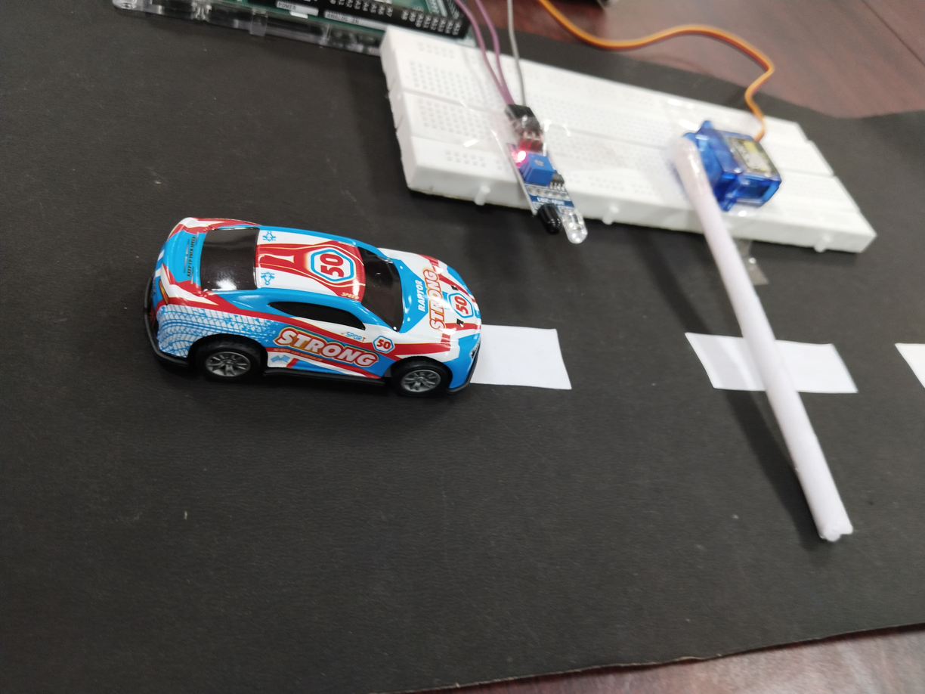
Automatic Garage Door Using Arduino Mega
D.SATHIYA PANDI
M.Sc.AI

Slide 2

Project Overview
Objective:
Design an automated garage door system that detects vehicles and opens/closes the garage door accordingly.

Slide 3
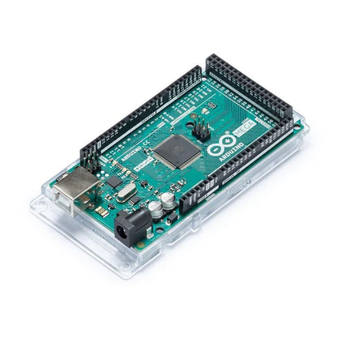
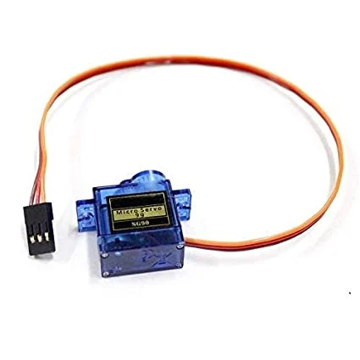
Components
Arduino Mega
Servo Motor
Controls the garage door
operation.
Operates the door opening and closing.

Slide 4
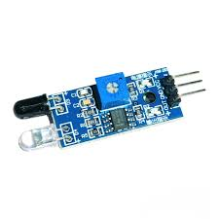
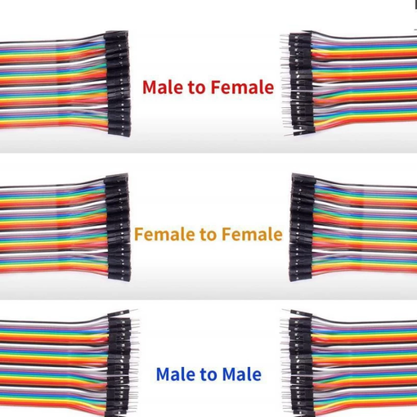
IR Sensor
Jumper Wires
Connect components and complete the circuit.
Detects vehicle presence.

Slide 5
Working Principle:
The IR sensor detects a vehicle, signaling the Arduino to open the door and automatically close it after a delay.

Slide 6
Circuit Diagram
Circuit Layout:
-> Sensor connected to pin 11 on the Arduino Mega.
-> Servo Motor connected to pin 13.
Explanation of Connections:
-> IR sensor and servo motor connections with jumper wires ensure a complete circuit.

Slide 7
System Workflow
Workflow Steps:
-> Detection: IR sensor identifies a vehicle.
-> Door Control: The servo motor opens the door on detection and closes it after a short delay.
Simple flowchart showing the process:
Start → Detect Object → Open Door → Delay → Close Door

Slide 8
Code Explanation
Setup and Loop Functions:
-> Servo Initialization: Sets the servo to the closed position (90°).
-> IR Sensor Input: Monitors for vehicle detection.
-> Door Control Logic: Opens the door to 180° and returns to 90° after a delay.

Slide 9
Code
#include <Servo.h>
Servo servo; // create servo object
// Define pins
const int irPin = 11; // IR sensor pin
const int servoPin = 13; // Servo motor pin
void setup()
{
// Initialize the servo motor
servo.attach(servoPin);
servo.write(90); // Set servo to default (closed) position
delay(2000);
// Set up the IR sensor pin as input
pinMode(irPin, INPUT);
// Start the serial monitor
Serial.begin(9600);
}
void loop()
{
// Read the IR sensor value
int irValue = digitalRead(irPin);
// Print the IR sensor state to the Serial Monitor
Serial.print("IR Sensor Value: ");
Serial.println(irValue);
// Check if the IR sensor detects an object (HIGH state when object is detected)
if (irValue == HIGH)
{
// Open the gate
servo.write(180);
delay(200); // Reduce delay to close the gate sooner
servo.write(90); // Close the gate after delay
}
}

Slide 10
Applications
Use Cases:
-> Residential Garages: Hands-free access for vehicles.
-> Commercial Parking Garages: Streamlines entry and exit.
-> Benefits: Increases convenience, security, and reduces manual operation.

Slide 11
Challenges and Solutions
Challenges Faced:
-> IR sensor sensitivity, servo angle accuracy, and stable connections.
Solutions: Calibrating sensor placement, precise servo settings, and using secure jumper wire connections.

Slide 12
Future Enhancements
RFID Access Control: Restrict entry to authorized vehicles.
Mobile App Control: Enable remote operation via smartphone.
Road Safety Sensors:
-> Hole Width Detection: Measure road holes to prevent damage.
-> Water Level Monitoring: Alert for potential flooding or slippery conditions on the driveway.

Slide 13
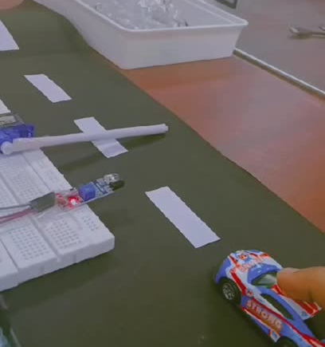
Output

Slide 14
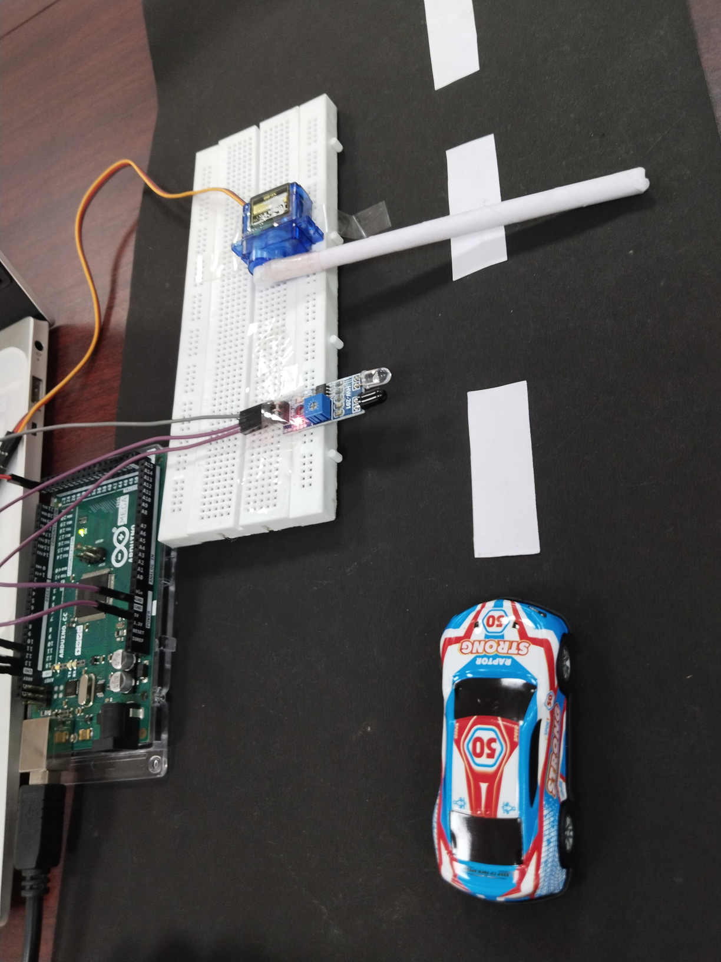
THANK YOU...

